Slide 2
Introduction to Supervisory control, advanced control topics and DTU Wind Energy Controller
Wind Turbine Control Online Course
Alan Wai Hou Lio
Researcher, DTU Wind Energy
wali@dtu.dk

Slide 3
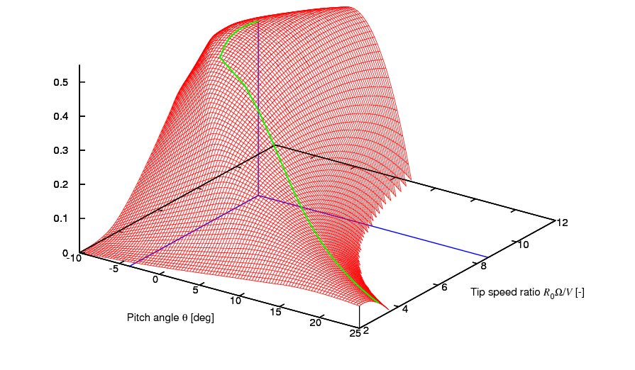
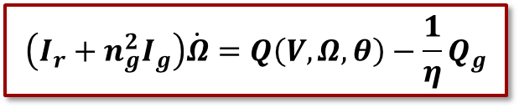
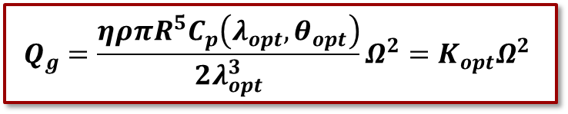



Re-cap
Region 2.5
Region 3
Region 2
Three operational regions.
Region 2 Controller:
Transient analysis:
$$Q_{g}=\frac{ηρπR^{5}C_{p}\left(λ_{opt},θ_{opt}\right)}{2λ_{opt}^{3}}Ω^{2}=K_{opt}Ω^{2}$$
Region 2
Region 2.5
$${θ=θ}_{opt}$$
Cp
Region 3
$$\left(I_{r}+n_{g}^{2}I_{g}\right)\dot{Ω}=Q\left(V,Ω,θ\right)−\frac{1}{η}Q_{g}$$
$$λ_{opt}$$
$$θ_{opt}$$

Slide 4

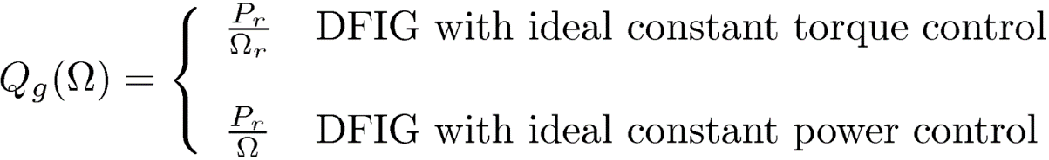


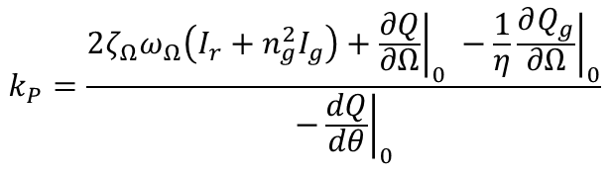
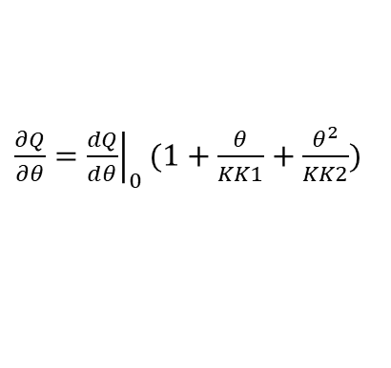
Re-cap
Region 2.5
Region 3
Region 2
Gain for Region 2.5
Gain for Region 3
Gain scheduling
$${k_{P}}_{g}=η\left(2\left(I_{r}+n_{g}^{2}I_{g}\right)ω_{Ω_{g}}ζ_{Ω_{g}}+\frac{∂Q}{∂Ω}{\left.​\right|}_{op}\right)$$
$$k_{P}=\frac{2ζ_{Ω}ω_{Ω}\left(I_{r}+n_{g}^{2}I_{g}\right)+{\left.\frac{∂Q}{∂Ω}\right|}_{0} −\frac{1}{η}{\left.\frac{∂Q_{g}}{∂Ω}\right|}_{0}}{−{\left.\frac{dQ}{dθ}\right|}_{0}}$$
$$k_{I}=\frac{ω_{Ω}^{2}\left(I_{r}+n_{g}^{2}I_{g}\right)}{−{\left.\frac{∂Q}{∂θ}\right|}_{0}}$$
$\frac{∂Q}{∂θ}={\left.\frac{dQ}{dθ}\right|}_{0}(1+\frac{θ}{KK1}+\frac{θ^{2}}{KK2})$

Slide 5
Learning Objective
Switching strategy between Regions
Torque limits
PI Anti-windup
Start-up and Shut-down procedure
Damage Equivalent Load (DEL)
Peak Shaving
Advanced Control Topics

Slide 6
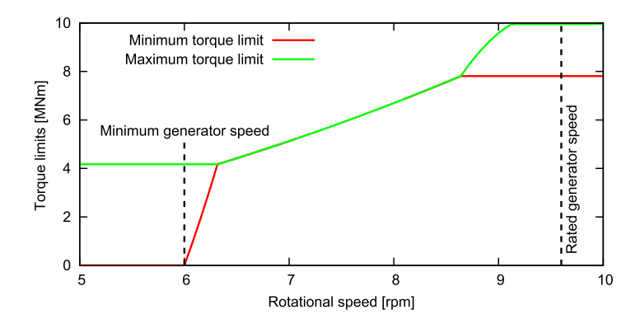



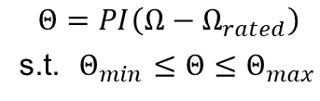
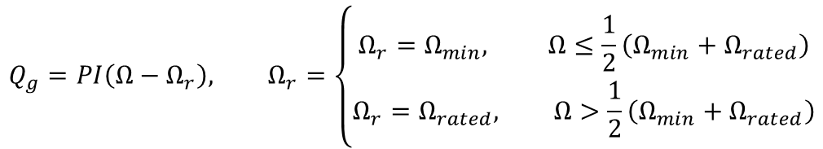
Switching between Regions
 | Region 2 and Region 2.5 | Region 3
Generator Torque | PI with limits | Const. Torq. or Const. Pow.
Pitch | PI with limits | PI with limits
Generator Torque: PI with limits
Pitch: PI with limits
$$Q_{g}=PI\left(Ω−Ω_{r}\right), Ω_{r}=\left\{\begin{aligned}Ω_{r}=Ω_{min}, Ω≤\frac{1}{2}\left(Ω_{min}+Ω_{rated}\right) \\ Ω_{r}=Ω_{rated}, Ω>\frac{1}{2}\left(Ω_{min}+Ω_{rated}\right)\end{aligned}\right.$$
$$Θ=PI\left(Ω−Ω_{rated}\right)$$ s.t. $Θ_{min}≤Θ≤Θ_{max}$
$$Θ_{min}$$
$$K_{opt}Ω^{2}$$
Defined in wpdata.100
To prevent high thrust
$$v$$
Region 1.5

Slide 7
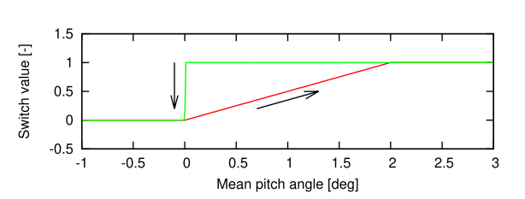





Switching
Switching value $σ$ between Region 2.5 and Region 3 is dependent on the pitch angle $Θ$
Pitch angle $Θ$ starts increasing if $Ω>Ω_{rated}$
Generator torque will gradually become Const. Torq. or Const. Pow.
$$Q_{g}=\left(1−σ\right)Q_{g,partial}+σQ_{g,full}$$
$$σ$$
See code f_controller.m
$Θ_{min}$ (user defined)
$Θ_{min}+Θ_{th}$ (user defined)

Slide 8
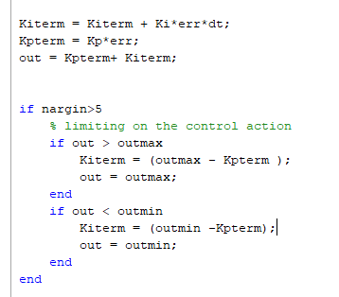
Anti-wind up in PID
Region 2.5
Region 3
Region 2
Integral term in PI has a memory of previous error.
How to prevent the integral term goes to infinity?
Anti-windup strategy.
See code f_PID_fast.m

Slide 9
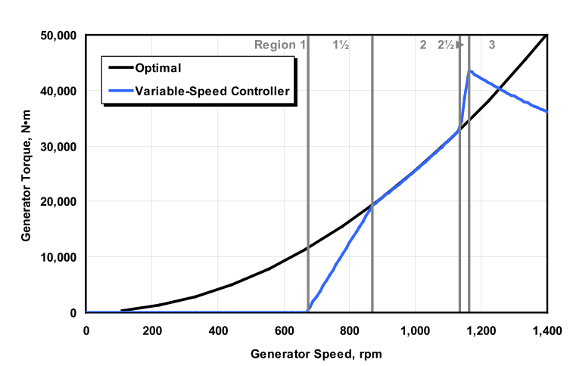




Two methods in Region 2.5
DTU: PI with limits
PI
NREL: Linear law $K_{2.5}(Ω−Ω_{90})$
$$K_{opt}Ω^{2}$$
$$K_{opt}Ω^{2}$$
$$K_{2.5}=\frac{Q_{g,max }−K_{opt}Ω_{90}^{2}}{Ω_{r}−Ω_{90}}$$
Hansen, M. H., & Henriksen, L. C. (2013). Basic DTU Wind Energy controller. DTU Wind Energy.
Jonkman, J., Butterfield, S., Musial, W., & Scott, G. (2009). Definition of a 5-MW Reference Wind Turbine for Offshore System Development. Golden, CO. https://doi.org/10.2172/947422

Slide 10
Exercise: Transition Strategy
Comparison between DTU Controller and NREL Controller
Exercise: Comparison between DTU Controller and NREL Controller
Open Part_6.m
Run the script to perform a step wind speed simulation. What do you see?
Perform a turbulent wind simulation (wind_no = 3). Which one generates more energy? How about the tower loads (displacement)?

Slide 11
Exercise: Transition Strategy
DTU: 1.1903MWh
NREL: 1.1716MWh

Slide 12






Torque Limit
What if we let $K_{opt}Ω^{2}$run longer?
Can we get more power?
$Ω_{min,1}=Ω_{min}$
$Ω_{min,2}=Ω_{min}/γ$
$Ω_{max,1}=\left(2γ−1\right)Ω_{rated}$
$Ω_{max,2}={γΩ}_{rated }$
By default, the opening of torque limit $γ$ is set to 0.95.
DTU: PI with limits
$$K_{opt}Ω^{2}$$
$$Ω_{min,1}$$
$$Ω_{max,2 }$$
$$Ω_{max,1 }$$
$$Ω_{min,2}$$

Slide 13
Torque Limit: Step wind
Baseline: 0.6717 MWh
TorqLimit: 0.6749 MWh
But high loads

Slide 14
Exercise: Torque Limit
Exercise: Torque limit
Open Part_8.m
The code contains two turbulent wind simulation (baseline and torque limit) at v = 12 m/s.
Increase the opening of torque limit to 0.99 at line 50. (Baseline: 0.95). Run the code
Which one generates more energy? How about the tower loads (displacement)?

Slide 15

Start-up and shut-down
During start-up,
Generator torque $Q_{g}$: maintains at 0 until the rotor speed reaches its minimum $Ω_{min}$
Pitch angle $Θ$: maintains at optimal pitch or at some degrees to prevent large thrust.
During shut-down,
Generator torque $Q_{g}$: linearly decreases to zero with user-defined time constant
Pitch angle $Θ$: linearly pitching out with user-defined pitch velocity

Slide 16
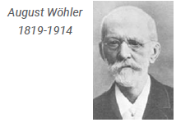
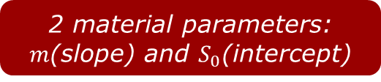

Damage Equivalent Loads (DEL): Quantifying damage
Fatigue: the gradual accumulation of damage through loading cycles
Central damage concept:
Enough load cycles of a certain amplitude cause a part to break.
Hypothesis:
More load cycles or higher amplitudes cause faster destruction.
Research question:
What is the relation between the amplitude of the load cycles and the number of cycles to failure?
$$S_{0}$$
2 material parameters: $m$(slope) and $S_{0}$(intercept)

Slide 17

Damage Equivalent Loads (DEL): Cycles and damage
SN curve:
$N={\left(\frac{S_{0}}{S}\right)}^{m}$
Consider load amplitude $S_{i}$that occurs $n_{i}$times. The accumulated damage is:
$D_{i}=\frac{n_{i}}{N_{i}}$
Equivalently,
$D_{i}=\frac{n_{i}S_{i}^{m}}{S_{0}^{m}}$
$$S_{0}$$
We assume m=4 for metals, m=10 for composites.
Given a cyclic load, we can now calculate damage!

Slide 18
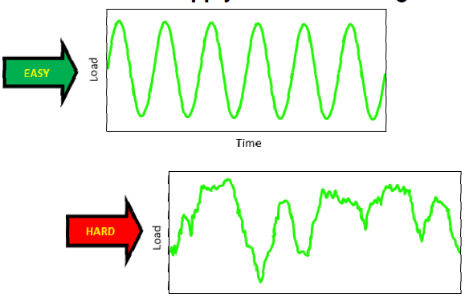
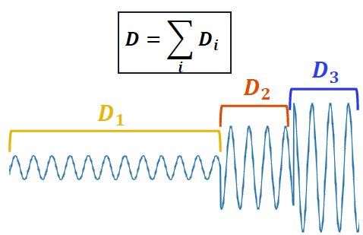

But how to apply this to a real signal?
We need to covert a time signal to equivalent number of cycles with amplitudes.

Slide 19
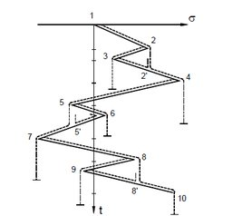

Rainflow counting
Convert time series to “peaks and valleys”.
Apply rainflow counting algorithm (rainflow() in Matlab)
The algorithm will give you:
Number of cycles $n_{i}$ at different amplitudes $S_{i}$

Slide 20
DEL: Rainflow counting algorithm
Rules:
Starting from valley
If the sequent valley is lower than the starting valley, stop and count as ½ cycle
If not, continue the flow
Starting from peak
If the sequent peak is higher than the starting peak, stop and count as ½ cycle
If not, continue the flow
There exists many other methods. All of them should give you the same results.

Slide 21
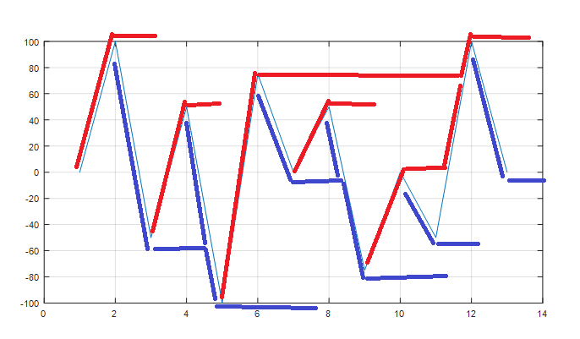
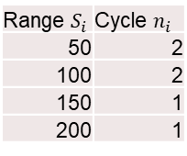
DEL: Rainflow counting algorithm
Range | Cycles
100 | 0.5
200 | 0.5
100 | 0.5
100 | 0.5
200 | 0.5
150 | 0.5
50 | 0.5
50 | 0.5
150 | 0.5
50 | 0.5
50 | 0.5
100 | 0.5
Range $S_{i}$ | Cycle $n_{i}$
50 | 2
100 | 2
150 | 1
200 | 1
C = rainflow(X)
%cycles %range %mean % start %end
0.5000 100.0000 50.0000 1.0000 2.0000
1.0000 100.0000 0 3.0000 4.0000
1.0000 50.0000 25.0000 7.0000 8.0000
1.0000 50.0000 -25.0000 10.0000 11.0000
1.0000 150.0000 0 6.0000 9.0000
0.5000 200.0000 0 2.0000 5.0000
0.5000 200.0000 0 5.0000 12.0000
0.5000 100.0000 50.0000 12.0000 13.0000
X = [0,100,-50,50,-100,75,0,50,-75,0,-50,100,0];

Slide 22
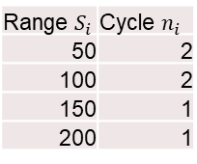
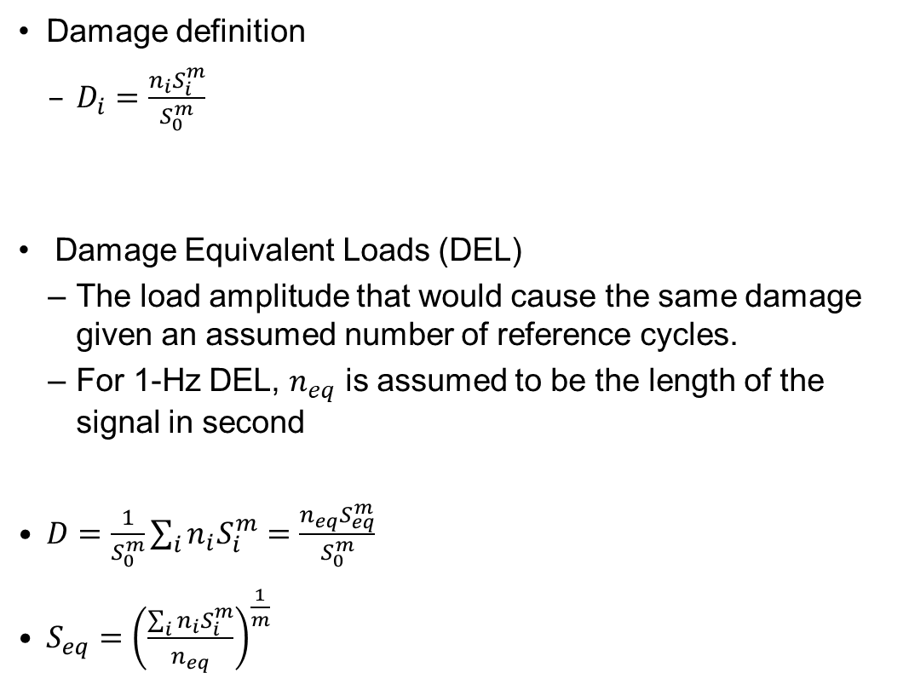
DEL: calculating the damage
Range $S_{i}$ | Cycle $n_{i}$
50 | 2
100 | 2
150 | 1
200 | 1
Damage definition
$D_{i}=\frac{n_{i}S_{i}^{m}}{S_{0}^{m}}$
Damage Equivalent Loads (DEL)
The load amplitude that would cause the same damage given an assumed number of reference cycles.
For 1-Hz DEL, $n_{eq}$ is assumed to be the length of the signal in second
$D=\frac{1}{S_{0}^{m}}\sum_{i}{n_{i}S_{i}^{m}}=\frac{n_{eq}S_{eq}^{m}}{S_{0}^{m}}$
$S_{eq}={\left(\frac{\sum_{i}{n_{i}S_{i}^{m}}}{n_{eq}}\right)}^{\frac{1}{m}}$
We assume m=4 for metals, m=10 for composites.
S = ?, n = length of signal in second
This is DEL
=

Slide 23
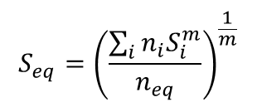
Exercise: DEL
Y = [-2,1,-3,5,-1,3,-4,4,-2];
$$S_{eq}={\left(\frac{\sum_{i}{n_{i}S_{i}^{m}}}{n_{eq}}\right)}^{\frac{1}{m}}$$
Time [s]
Exercise: Calculate the DEL of the signal
Do a rainflow flow counting on the signal by hand. i.e. do a range and cycels table
Check with Matlab if your table is correct (Matlab command: rainflow(Y))
Calculate the 1-Hz DEL based on your table, assuming m = 4.

Slide 24
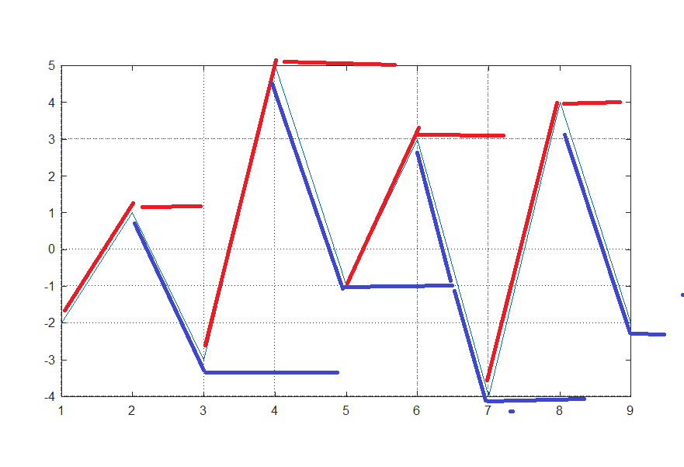
Answer
Range | Cycles
3 | 0.5
4 | 1.5
6 | 0.5
8 | 1
9 | 0.5
DEL: ((3^4*0.5+4^4*1.5+6^4*0.5+8^4*1+9^4*0.5)/9)^(1/4) = 5.5353

Slide 25
Peak shaving
Peak thrust load is at maximum around rated wind speed.
Thrust can be reduced by increasing the pitch
How to implement?
Change the minimum pitch angle
In wpdata.100

Slide 26
Exercise: Peak shaving
Exercise: Peak shaving
Open Part_7.m and run a steady-state plots of power, thrust, pitch and rotor speed
Modify wpdata_DTU10MW_Part7.100 file with your chosen pitch angles.
Run Part_7b.m to see the steady-state of your design. Your chosen pitch angles needs to make the thrust within 1.3MN.
Run Part_7c.m to perform a turbulent wind simulation. Do you see a trade-off between power and tower loads?

Slide 27
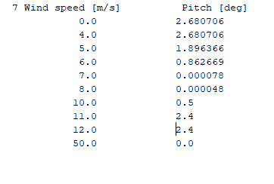
Exercise: Peak shaving
Blue: Baseline [0.7997 MWh]
Red: Peak shaving [0.7931 MWh]

Slide 28
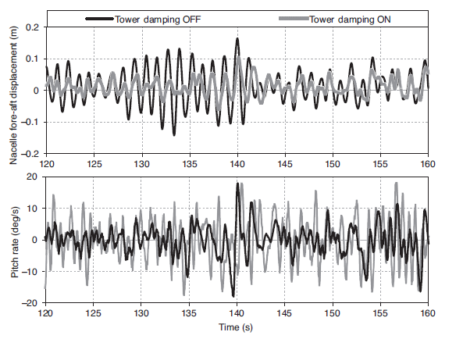
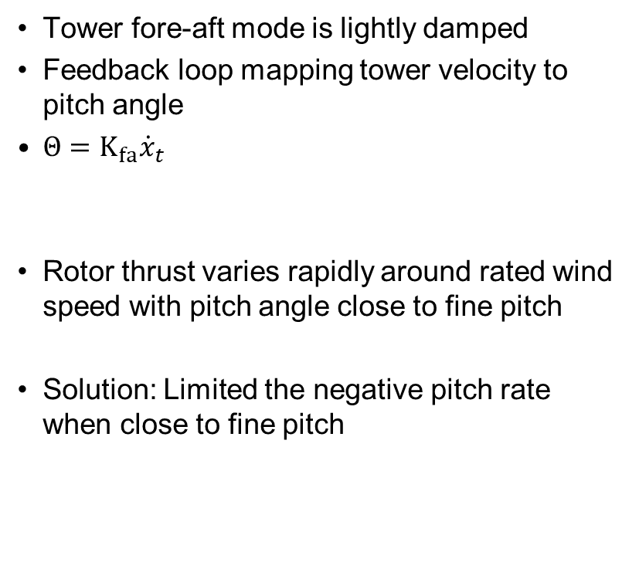




Advanced Control topics: Control of tower fore-aft vibration
Basic Controller
Wind Turbine
$${\dot{x}}_{t}$$
$$Θ$$
Tower fore-aft mode is lightly damped
Feedback loop mapping tower velocity to pitch angle
$Θ=K_{fa}{\dot{x}}_{t}$
Rotor thrust varies rapidly around rated wind speed with pitch angle close to fine pitch
Solution: Limited the negative pitch rate when close to fine pitch
$$Q_{g}$$
$$Ω$$

Slide 29

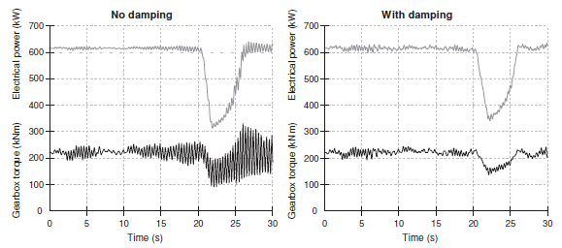



Advanced Control topics: Control of drive-train torsional vibration
Band-pass filter
Basic Controller
$$Q_{g}$$
Wind Turbine
Torsional vibration is coupled with the first blade-edgewise mode
At above-rated wind region, the generator torque is designed to dampen the torsional vibration
A band-pass filter is used
$$Θ$$
$$Ω$$

Slide 30
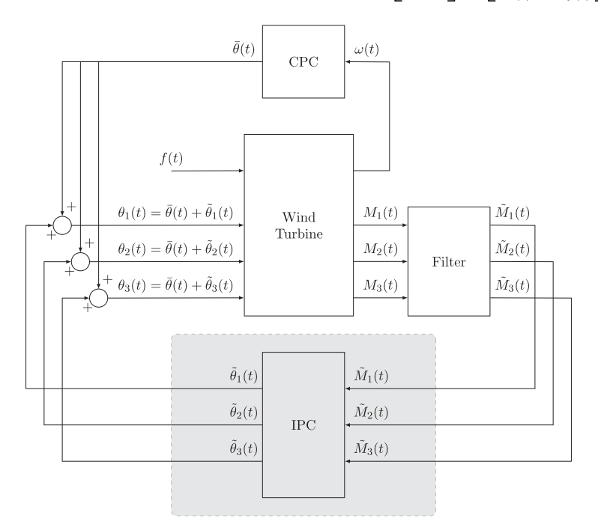
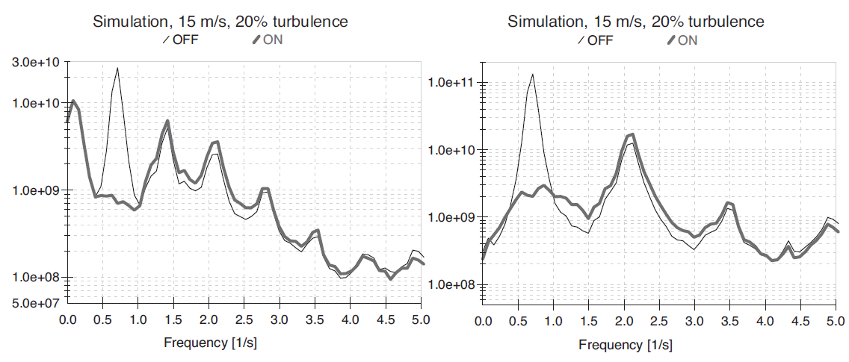
Advanced Control topics: Individual Pitch Control
Turbines are subject to periodic loadings:
Wind shear, tower shadow
Cyclic pitch control: azimuth-dependent change to the demand pitch angle for each blade
Turbulent variations in wind speed across a large turbine rotor dominates the asymmetrical loadings.
Individual Pitch Control:
Use load sensor to measure blade bending moment
Adjust the blade individually

Slide 31
Summary
After this lecture, you should be able to:
Understand the switching logics behind a wind turbine controller
Tune the opening of torque limit
Calculate the DEL
Design a peak shaving strategy

